Slide 1
Axiom Independence
By
Dan McAloon
TJ Root

Slide 2
Independence Checking
By Hand
  Tedious
  Slow
  Error Prone
Computerized
  Slow (for systems with many variables)
    ...or more than 2 really...
  Accurate
  Fun?

Slide 3
The process
Replace truth-values with schmuth-value assignments:
  function which maps letters of propositional logic to the set of numbers (1,2,3...etc.) or another set such as letters (a,b,c)...
  alter “and”, “not” and “or” tables to find combination that evaluates to a unique result (i.e. all of the statements except 1 are “A” tautologies, or “B” tautologies, etc.)

Slide 4
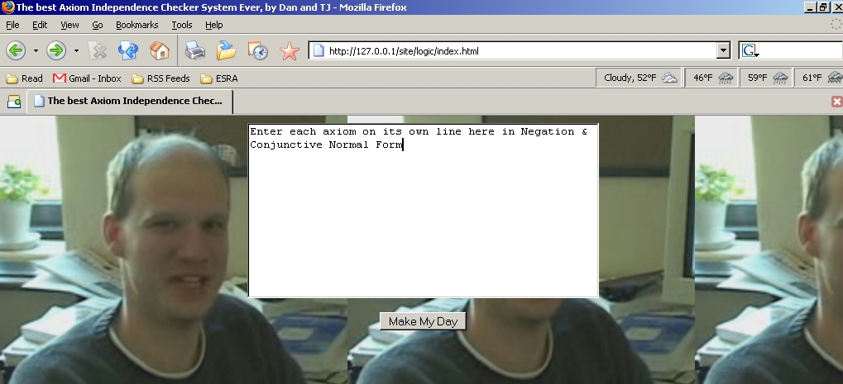
The Interface

Slide 5
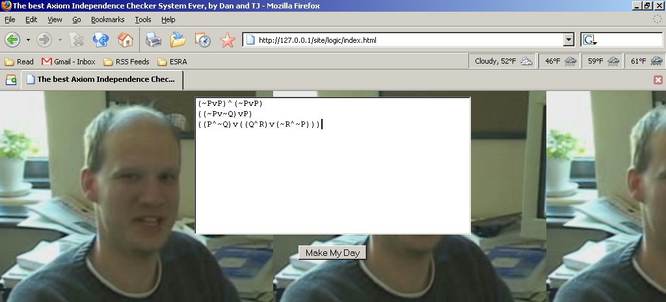
Enter Your Axioms

Slide 6
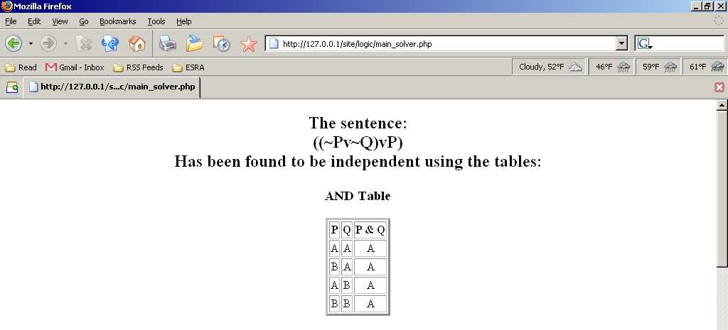
The Output

Slide 7
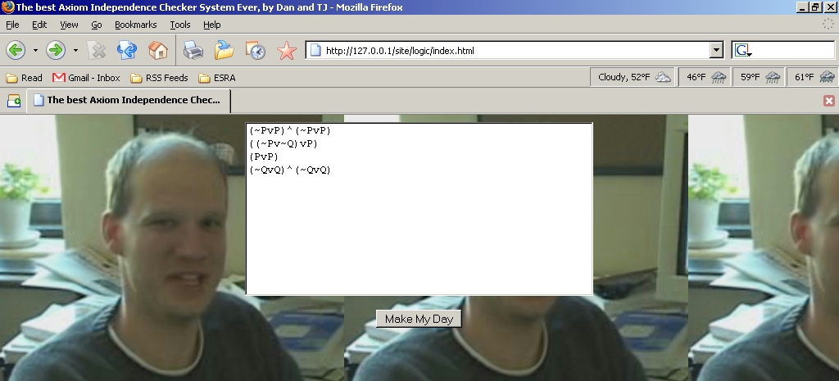
Ok, what if you’re wrong?

Slide 8
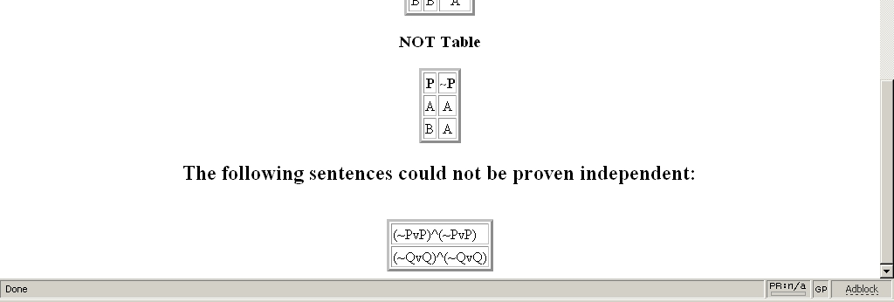
INVALID! Thanks for playing...

Slide 9
Demo

Slide 10
Questions

